Slide 1
Simple Random Sampling
Presenters –
Anurag Singari (SS2122480)
Sandhya Poojari (SS2122470)
Anshu shah (SS2122475)
Asha Shaikh (SS2122477)
Prakash Singh (SS2122481)
Rohan Yeldi (SS2122484)
Ankit Yadav (SS2122483)
Sujit Salunkhe (SS2122474)
Vikas Ganji (SS2122457)

Slide 2
Introduction
We have conducted a survey on “Simple Random Sampling” topic to understand the concept and do some analysis based on the actual survey passed onto our teammates with the help of some question in the google form.

Slide 3
Data Collection & Data Analysis
Data Collection
Data Analysis
Population size : 9
Sample size : 4
Used Method : Survey ( Through Google Form)
Question Asked :
1) How much time do you spend on watching “Reality Shows” ?
2) Do you watch “Reality shows” ?
Used Software : 1) Python
2)MS-Excel
Used Method for sampling : Simple Random Sampling ( without Replacement)

Slide 4

Simple Random Sampling

Slide 5
Pie Diagram(for Attributes)
Frequency graph of samples watching “Reality Shows”
As our first question was “Do you watch reality shows?”we made a pie diagram.
Here the small slice of pie indicates the no.of population do not watch reality shows and the remaining slice of pie indicates the no.of population to watch reality shows.

Slide 6
Frequency Graph (for Variables)
Frequency graph of samples watching “Reality Shows”
As our second question was “How much time do you spend on watching “Reality Shows?” we made a frequency graph.
Here horizontal X-axis indicates time spent in watching reality shows (in minutes) And vertical Y-axis indicates no.of population.

Slide 7
Analysis of Attributes For Population:
By the use of Excel we found the Population proportion ,Population variance and Population S.E. Which is given in the table.
Population proportion | 0.777778
Population variance | 0.1728
Population S.E. | 0.4157

Slide 8
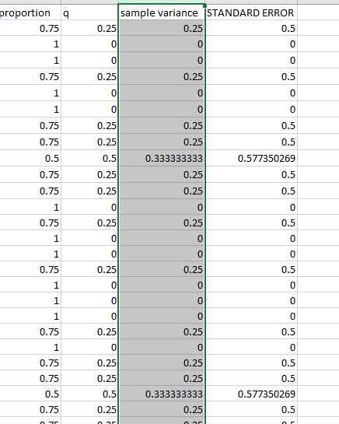
For sample :
By using Python, We generated
sample of size 4 taken as without
replacement and with the help of
Excel we calculated the sample
proportion , sample variance, and
sample S.E.

Slide 9
Verification of Results
Verification of E(p) = P
As shown earlier P = 0.7778
And for E(p) we calculated the proportion of each samples (i.e. 126 samples) and then we took the average of all the sample proportion (i.e. 126 Sample mean)
Thus, we got E(p) = 0.7778

Slide 10
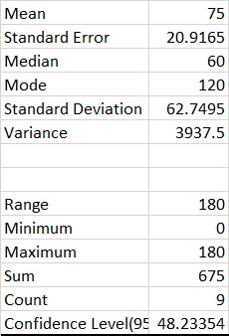
Analysis of variable For Population:
To calculate the population mean, variance, standard deviation, we used the “Data analysis” tab.
The calculated values are given in the table.

Slide 11
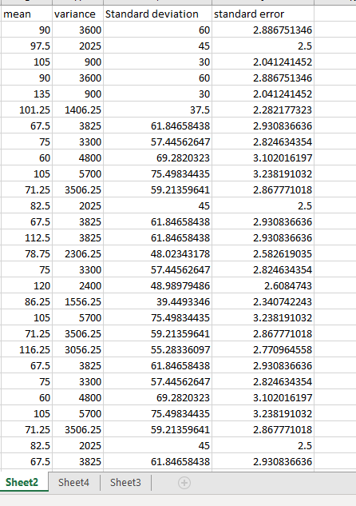
For sample :
As said earlier we used the python for generating 126 samples taken out as without replacement.
We used various in build formulae of Excel to calculate the sample mean ,sample variance, sample S.E. E.g. “AVERAGE”, ”VAR.S”, “STDEV.S” etc.

Slide 12
Verification of Results:
Verification of E(y_bar) = Y_bar.
As Population Mean (Y_bar) = 75
And for E(y_bar) we calculated the mean of each samples (i.e. 126 samples) and then we took the average of all the sample mean (i.e. 126 Sample mean)
Thus, we got E(y_bar) = 75.

Slide 13
Verification of E(s^2)=S^2
As Population Variance (S^2) = 3937
And for E(s^2) we calculated the variance of each samples (i.e. 126 samples) and then we took the average of all the sample variance (i.e. 126 Sample variance)
Thus, we got E(s^2) = 3937

Slide 14
Conclusion
From the analysis we concluded that,
Majority of the Population watch reality shows.
On an average population spend 75 min on watching Reality shows.
Verified results :
E(p) = P E(y_bar) = Y_bar
E(s^2) = S^2 (For variable)

Slide 15
THANK YOU!

